Slide 1
UNIVERSIDAD PANAMERICANA
Campus Bonaterra
How to start a test automation framework and not die trying
Name: Juan Delgado and Isaac Méndez Altuzar
Date: October 14th, 2019

Slide 2
Agenda
Biography
Overview
Android Mobile Devices for Testing
Android Testing Concept
Methodologies and Process in class
Tools
UP Automation Framework
Benefits
Demo
Questions

Slide 3
Learning Points
Testing and Test Automation – Where to use test automation and where to use manual testing.
Mobile Testing – How to implement a test automation framework as part of your mobile testing effort to reduce manual testing.
Scrum – How to approach test automation using a scrum based model.

Slide 4
Biography

Slide 5
Biography
Juan has more than 10 years of experience as an engineer. He has worked with all kind of IT activities including development, support and in the past 7 years working on testing. He has a great knowledge in the areas of IT and business with a great interest in learning and analyzing business processes and experience in functional testing. He has worked on agile and waterfall projects and has been certified as Scrum Master and ITIL Foundations.
Juan has participated in different projects on US and Europe in the last years. He has worked on the client site in US and Europe, near shore from Mexico to US, offshore from Mexico and India to Europe; working strongly with functional testing and focusing on automated testing and business analysis.
Also, Juan is a Professor at Universidad Panamericana in the faculty of Engineering, focused on the subject of Software Quality Assurance and involved in the development and launch of interdisciplinary programs for students.
Isaac has more than 6 years of experience as a developer. He has worked in all kind of projects using C++, C#, Java, Python, PHP, JavaScript and SQL. He has experience in web development, android applications development, support and translations from Spanish to English. He went on an exchange program to Brazil and worked on a computational vision project in Japan. Also, he is the co-founder and general director of the software company called Byta Labs.

Slide 6
Overview
Notes:
Profesor: Las reglas del cursos y calendario

Slide 7
Overview
Testing is very important for software development companies because they need to guarantee their clients that their products are multiplatform, multidevice and that they will work correctly and efficiently. It is very important to perform testing during the entire development cycle and is essential to do it starting in the first stage of the project because this will reduce cost and time when fixing the bugs.
According to Oracle, industry surveys indicate that 75% of all functional testing is still done manually. That’s why we decided to develop this framework in order to make automation easier and save money for companies by reducing functional testing times.

Slide 8
Android Mobile Devices for Testing
Notes:
Profesor: Las reglas del cursos y calendario

Slide 9
Android Mobile Devices for Testing
It is important to acquire a wide array of devices for your mobile Quality Assurance lab. Naturally, the underlying platform plays a big role in device procurement, as it will probably need a host of smartphones and tablets from different companies.
A good cross-section of screen dimensions, processors, and manufacturers (for Android) helps to ensure your team can test apps and websites in a multi-device, multi-platform and multi OS-testing environment. Checking for overall performance on older devices is vital as well.
While working on the development of this project, we decided to incorporate a Smartphone Test Farm to assure future users can do this easily.

Slide 10
Android Testing Concept
Notes:
Profesor: Las reglas del cursos y calendario

Slide 11
Android Testing Concept
In testing, every test case is formed by many steps that must be achieved in order to determine if the test was successful or if it failed. In our project, a step will correspond to a certain task that has to be executed in the android device.
We run the test cases in different devices with the goal of obtaining statistics with strong foundations. There can be exceptions where we cannot execute some steps in a specific device, in this situation we must create a different test case or add the exception in the same test case.
When some step failed, the framework will log the failure with the description and the device where it occurred. It will also log when a step was executed successfully.
In order to achieve an accurate result of the test cases, we must run them many times depending on the type of application and on the type of testing that is required.

Slide 12
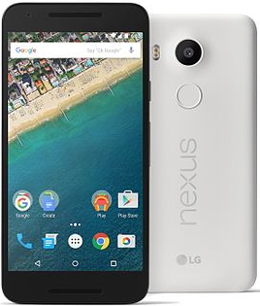
Android Testing Concept
Mobile App
Mobile App
Mobile App
Mobile App
Step 1
Step 1
Step 1
Step 1
Step 2
Step 2
Step 2
Step 2
Test
Case
# 1
Step 3
Step 3
Step 3
Step 3

Slide 13
Android Testing Concept
Mobile App
Mobile App
Mobile App
Mobile App
Launch Uber App
Step 1
Step 1
Step 1
Step 1
Step 2
Step 2
Step 2
Step 2
Step 3
Step 3
Step 3
Step 3

Slide 14
Android Testing Concept
Mobile App
Mobile App
Mobile App
Mobile App
Step 1
Step 1
Step 1
Step 1
Go Payment
Step 2
Step 2
Step 2
Step 2
Step 3
Step 3
Step 3
Step 3

Slide 15
Android Testing Concept
Mobile App
Mobile App
Mobile App
Mobile App
Step 1
Step 1
Step 1
Step 1
X
Step 2
Step 2
Step 2
Step 2
Add Payment
Method
Step 3
Step 3
Step 3
Step 3

Slide 16
Android Testing Concept
Mobile App
Mobile App
Mobile App
Mobile App
Step 1
Step 1
Step 1
Step 1
X
Step 2
Step 2
Step 2
Step 2
Add Payment
Method
X
Step 3
Step 3
Step 3
Step 3
Add Payment
Method - Paypal

Slide 17
Android Testing Concept
Mobile App
Mobile App
Mobile App
Mobile App
Step 1
Step 1
Step 1
Step 1
X
Step 2
Step 2
Step 2
Step 2
Add Payment
Method
X
Step 3
Step 3
Step 3
Step 3
Add Payment
Method - Paypal
All Brand Models???
All Android Versions??

Slide 18
Android Testing Concept
Samsung Popular Models
Galaxy S9
Galaxy S9 Plus
Galaxy Notes 8
X
Android Version
Pie (9)
Oreo (8)
Nougat (7)
Marshmallow (6)
=
1 Test Case need to be run 12 times

Slide 19
Android Testing Concept
Samsung Popular Models
Galaxy S9
Galaxy S9 Plus
Galaxy Notes 8
X
Android Version
Pie (9)
Oreo (8)
Nougat (7)
Marshmallow (6)
=
1 Test Case need to be run 12 times
Nexus Popular Models
One
S
Galaxy Nexus
X
Android Version
Pie (9)
Oreo (8)
Nougat (7)
=
1 Test Case need to be run 9 times

Slide 20
Android Testing Concept
Samsung Popular Models
Galaxy S9
Galaxy S9 Plus
Galaxy Notes 8
X
Android Version
Pie (9)
Oreo (8)
Nougat (7)
Marshmallow (6)
=
1 Test Case need to be run 12 times
Nexus Popular Models
One
S
Galaxy Nexus
X
Android Version
Pie (9)
Oreo (8)
Nougat (7)
=
1 Test Case need to be run 9 times
Include Regression Test to verify if the hotfix/fix not broke current functionality
TC time x Device = 10 min
Retest ≈ 2 hrs

Slide 21
Methodologies and Process in class

Slide 22
About the Course
Agenda
Presentations
Group dynamics
Story Telling
Case Method
Breaks

Slide 23
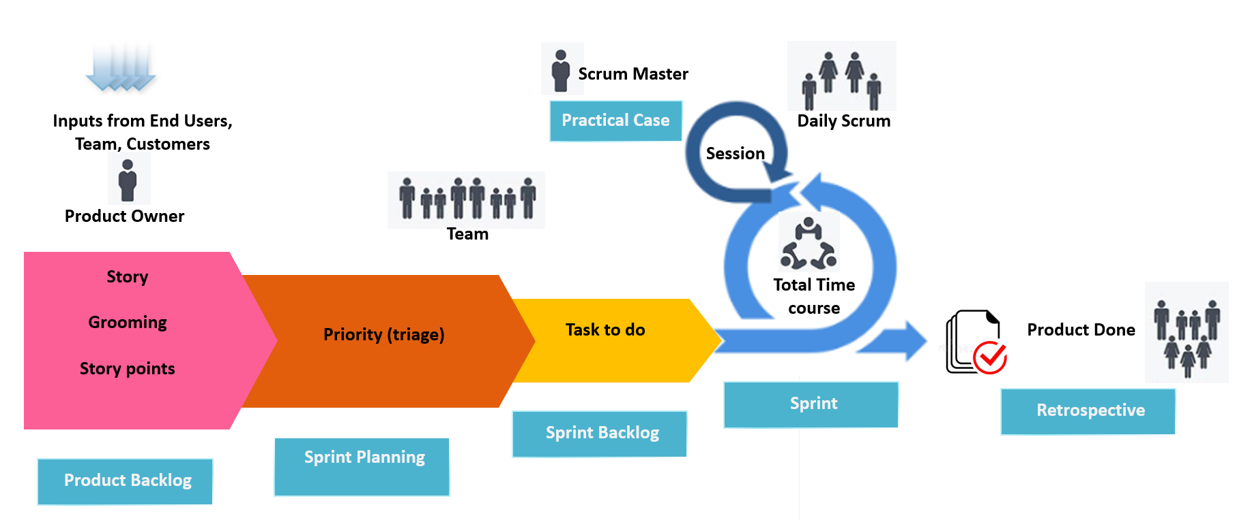
Scrum

Slide 24
Roles
Roles | Responsibilities
Product Owner | Responsible for the overall direction of the project
Scrum master (PM) | Responsible of ensuring a good relationship between the team and product owner and progress reporting
Consultant | Responsible for design, architecture and implementation of the AMX (Automation Mobile Experience) infrastructure.
SDET (Software Development Engineer in Test) | Responsible for the development of the core of the AMX Framework
Database Engineer | Responsible for the design and maintenance of the database
UI/UX Engineer | Responsible for the overall look & feel of the AMX
Tester | Responsible for testing the various portions of the application including end-to-end deployment

Slide 25
Tools

Slide 26
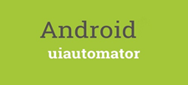
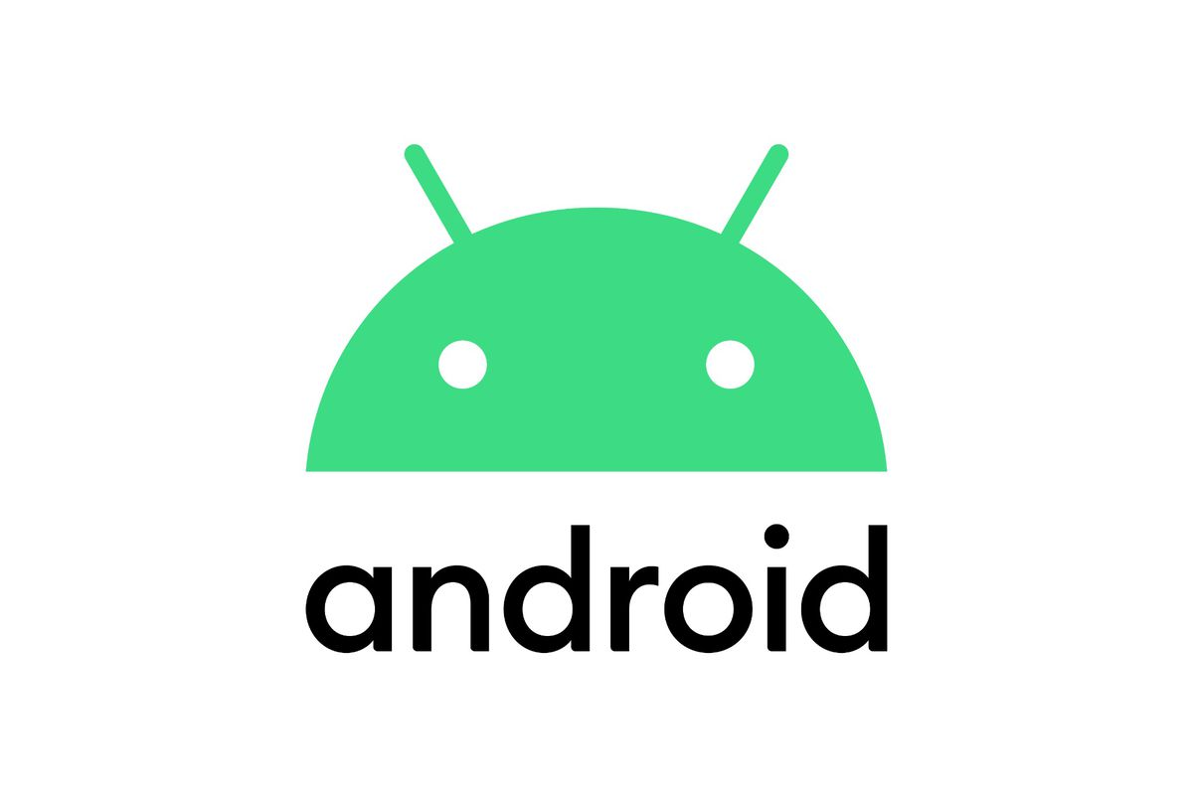
Tools
Development
Management
Testing
Database
Mobile Farm

Slide 27
UP Automation Framework

Slide 28
UP Automation Framework
Big Picture
Project
Automation team will understand the new app and will analyze the test cases and its priority
Test Design
Test Execution
Test Scripts into UP Framework
Develop the Automation Framework
Study the Test case, app, functionality, business process, etc
Test Planning
Develop test plan
Prioritize tests for Automation
Constraints/Risk Identification
Environment Verification
Identify Test Data
Prepare Test scripts
Debug Test Scripts
Run Test Scripts
Automation Suite
Test Signoff
Design Framework
Maintenance of Automated Project
Test Script Revision
Understand the changes
Test Execution
Upload Test Scripts into UP Framework
Update the Test scripts with new application changes
Run Test Scripts
Execute the Tests
Log Defects
Test Signoff
Defect Log
Test Results
Change Impact Report
Revised Test Scripts

Slide 29
UP Automation Framework
Implementation
Identify and Prioritization
Analyze SRS
Identify Functionality
Identify priority scenarios & highest reusability
Prepare the Framework
Create New environment of Devices
Build New Libraries
Identify Reusable Libraries
Identify Data and Data Validation
Framework development
Automation
Test Cases Candidate to Automation Priority List
Create the Automated Test Cases
Run
Debug Scripts
Validate and approve test results
Integrate Automation scripts with New UP Framework

Slide 30
UP Automation Framework
Timeline
Project TimeLine
Analysis
New App Test Certification
Data Integrity
GUI
Execution
UP SDK & Libraries
Start Project
UP
Framework
Setup
Environment
Build Reusable Test Libraries
Run Tests
Analyze
Results
Modify Tests

Slide 31
UP Automation Framework
Approach
UP GUI
GUI
“HOW TO EXECUTE”
Scripts – Test Suite
Test Script
“WHAT TO DO”
UP Framework
Implemented wrapper to use UP libraries and external libraries
Test Libraries / Standard Libraries
Libraries
HOW TO DO IT
Android
Android Device
Application Under Test
Mobile App

Slide 32
UP Automation Framework
Structure
GUI
ADB
Data Repository
File Manager
Logs
My App
My Device
STF Device
Lib
Demo

Slide 33
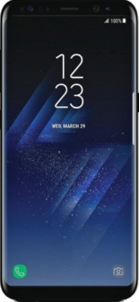
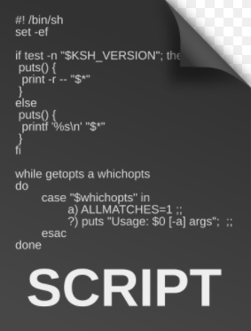
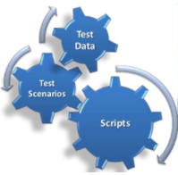
UP Automation Framework
Architecture
App
Repository
Continuous Delivery
Execution
Deploy to Production
Continuous Integration
Server
Test Script
Test Script
Manual Testing
Code
Code
UP Framework
Environment - STF

Slide 34
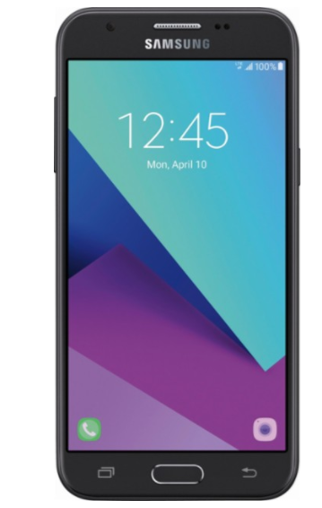
UP Automation Framework
Proof of Concept
Results
UP Framework
Device UT

Slide 35
Benefits
Test Cycle | Manual time | Automated time | Delta
20 devices 2 cycles 1 day | 4 hours 42 minutes | 1 hour 24 minutes | 3 hours 18 minutes
20 devices 2 cycles 30 days | 141 hours 24 minutes | 42 hours 17 minutes | 99 hours 6 minutes

Slide 36
Demo https://github.com/Isaac95Mendez/AMX-Framework

Slide 37
QUESTIONS

Slide 38
UNIVERSIDAD PANAMERICANA
Campus Bonaterra
How to start a test automation framework and not die trying
Name: Juan Delgado and Isaac Méndez Altuzar
Date: October 14th, 2019

